Slide 1
Henri Matisse
By Joshua Lathbridge

Slide 2
Matisse's life
Henri-Élemi-Benoît Matisse was born on the 31st of December, 1869 and studied law, but in the end became a painter in France. In 1891 he studied at the Academie Julian in Paris, learning from the artists William-Adolphe Bouguereau and Gustave Moreau. Henri Matisse had done a lot of paintings and sculptures in his life time. Sadly, he died on November 3rd, 1954. He had done thousands of paintings in his life time.

Slide 3
The beginning o his career
At the beginning of his career, Matisse focused on painting landscapes and still-lifes in a traditional style. Following a meeting with the Australian artist, John Peter Russell, Matisse’s style changed. He started to produce work influenced by the Impressionist movement and he also admired the work of Cezanne.

Slide 4
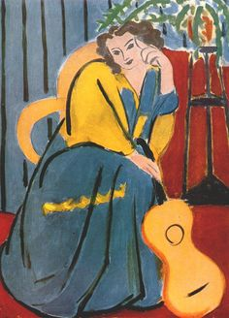
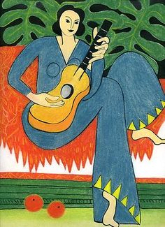
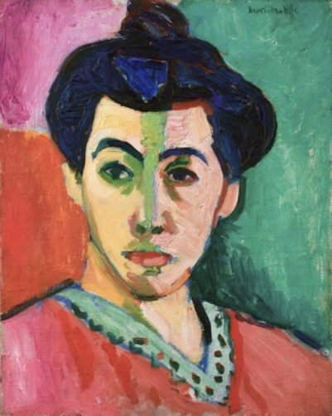
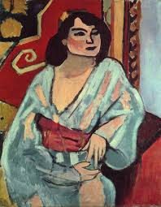
Art drawn by him
He was known for a lot of his art, paintings and sculptures.
Here are some below...

